Slide 1
This slide is hidden.
Insert the starting slides after this slide

Slide 2

Welcome to St Michael’s
26th Sunday in Ordinary Time Year C
(Social Justice Sunday)
Please ensure all mobile phones are switched off.
Please be respectfully quiet as we prepare for our Celebration.
Notes:
Saturday 5.30PM First Sunday of Advent
7am - 22nd Sunday in Ordinary Time

Slide 3
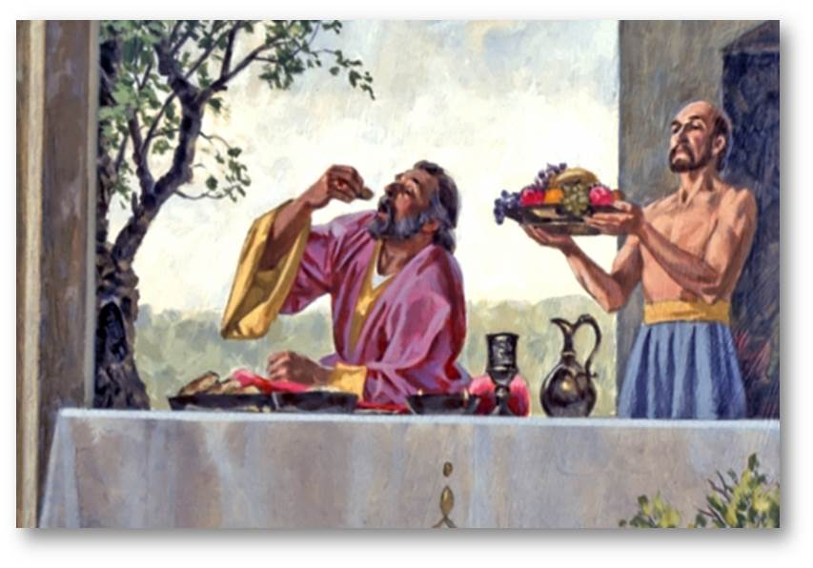
‘There was a rich man who used to dress in purple and fine linen and
feast magnificently every day…’

Slide 4
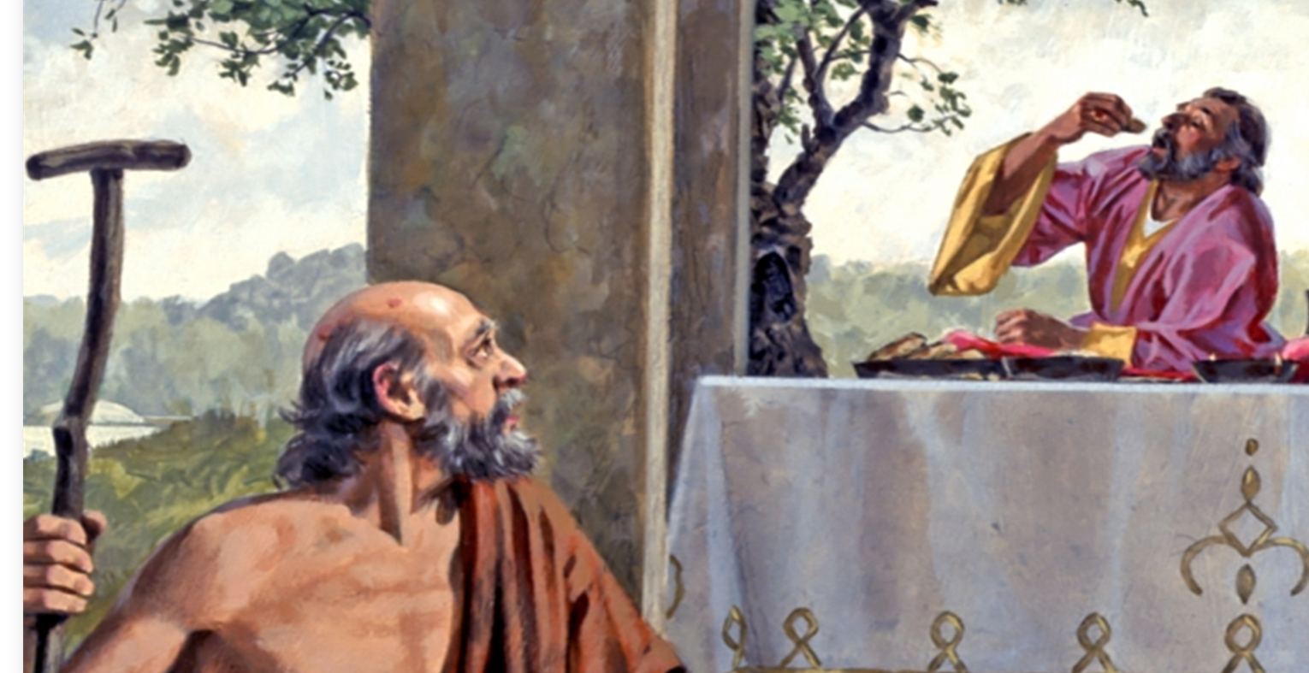
… at his gate there lay a poor man called Lazarus, covered with sores, who longed to fill himself with the scraps that fell from the rich man’s table …

Slide 5
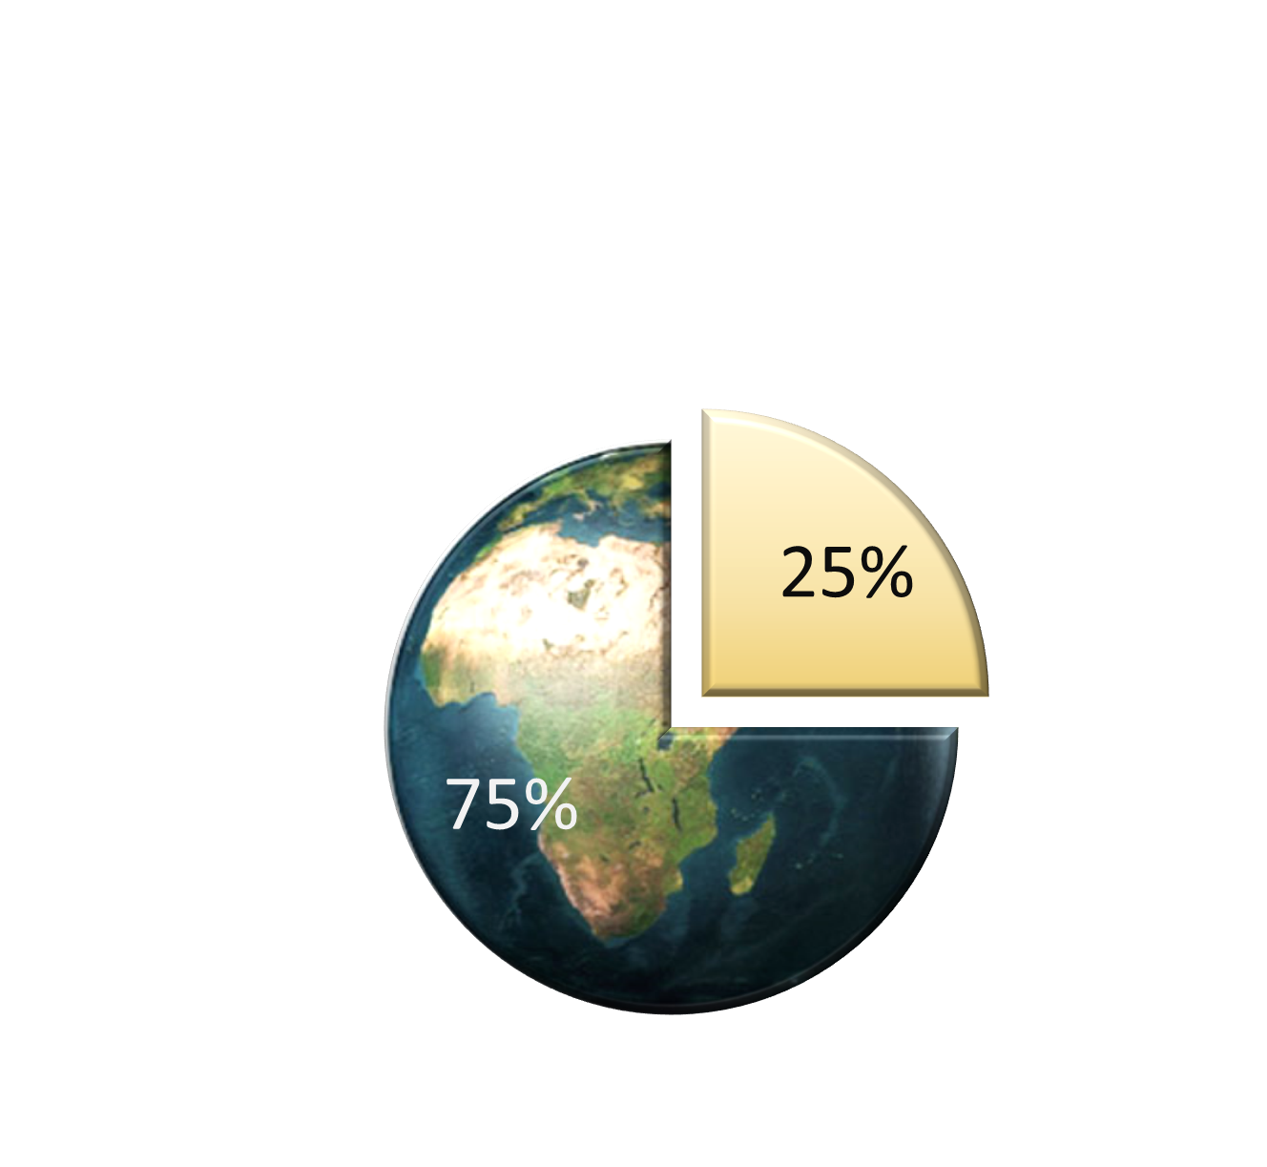


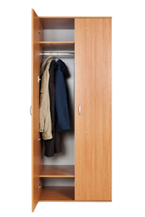
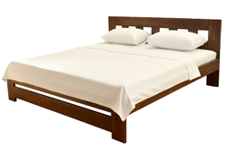
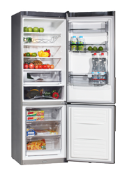
If you have food, clothes a bed and a roof over your
head …
You are richer
than 75 %
of the
world’s
population
…

Slide 6

What can I do to help Lazarus
at my gate?ep in …and a roof over your head …You are richer than 75 %
of the world’s population …

Slide 7
Please Stand

Slide 8
This slide is hidden.
Insert the Entrance Hymn after this slide

Slide 9
Praise the name of Jesus
Praise the name of Jesus
Praise him as we pray
Praise the name of Jesus
Sing to him all our days

Slide 10
From the rising of the sun
To the setting of the same
The name of the Lord is to be praised
In all things let's praise his name
And so let's

Slide 11
Praise the name of Jesus
Praise him as we pray
Praise the name of Jesus
Sing to him all our days

Slide 12
Let us come unto the Lord
Let us make a joyful noise
He has healed us through his word
In all things let's praise his name
And so let's

Slide 13
Praise the name of Jesus
Praise him as we pray
Praise the name of Jesus
Sing to him all our days
Sing to him all our days

Slide 15
Confiteor
I confess to almighty God
And to you, my brothers and sisters,
That I have greatly sinned
In my thoughts and in my words

Slide 16
In what I have done
And in what I have failed to do,
Through my fault,
Through my fault,
Through my most grievous fault;

Slide 17
Therefore I ask blessed Mary ever-Virgin,
All the Angels and Saints,
And you, my brothers and sisters,
To pray for me to the Lord our God.

Slide 19
Kyrie eleison
Kyrie eleison (2)
Christe eleison (2)
Kyrie eleison (2)

Slide 21
Glory to God
Glory to God in the highest,
And on earth peace to people of good will.
We praise you, we bless you,
We adore you, we glorify you

Slide 22
We give you thanks for your great glory,
Lord God heavenly King,
O God, almighty Father

Slide 23
Lord Jesus Christ, only begotten Son,
Lord God, Lamb of God,
Son of the Father,

Slide 24
You take away the sins of the world,
Have mercy on us;
You take away the sins of the world,
Receive our prayer;

Slide 25
You are seated
At the right hand of the Father
Have mercy on us

Slide 26
For you alone are the Holy One,
You alone are the Lord
You alone are the most High,
Jesus Christ

Slide 27
With the Holy Spirit,
In the glory of God the Father.
Amen!
Amen!

Slide 28
Gloria
Glory to God in the highest,
and on earth peace to people of good will.
We praise you, we bless you,
we adore you, we glorify you,

Slide 29
We give you thanks for your great glory,
Lord, God heavenly king,
O God, almighty father

Slide 30
Glory to God in the highest,
and on earth peace to people of good will.

Slide 31
Lord Jesus Christ, Only Begotten Son,
Lord God, Lamb of God, Son of the Father,
you take away the sins of the world,
have mercy on us;

Slide 32
you take away the sins of the world, receive our prayer;
you are seated at the right hand of the Father,
have mercy on us.

Slide 33
Glory to God in the highest,
and on earth peace to people of good will.

Slide 34
For you alone are the Holy One,
you alone are the Lord,
you alone are the Most High, Jesus Christ,
with the Holy Spirit,
in the glory of God the Father.

Slide 35
Glory to God in the highest,
and on earth peace to people of good will.
Amen.

Slide 37
Responsorial Psalm
Praise the Lord, my soul!

Slide 39
Alleluia
Alleluia, alleluia,
alleluia, alleluia

Slide 41
Insert Social Justice DVD/PowerPoint

Slide 43
A PRAYER FOR OUR PARISH
All praise and glory are yours, loving Father, maker and ruler of the universe; we praise you for calling us to be your people, your beloved sons and daughters.

Slide 44
Guide our community as we try to follow Jesus. Fill us with love for those in need of our help, and open our hearts to all. Let your Spirit teach us to serve in love and to praise you by our work and worship.

Slide 45
Father of all, we praise you through Jesus Christ, our brother, in the love of your Holy Spirit, now and forever, Amen.

Slide 46
Mary, Mother of the Church, pray for us.
St Michael, pray for us.
St Mary of the Cross Mackillop, pray for us.

Slide 48
Apostles Creed
I believe in God,
the Father almighty,
Creator of heaven and earth,
and in Jesus Christ, his only Son, our Lord,
(At the words that follow, up to and including the Virgin Mary, all bow.)

Slide 49
who was conceived by the Holy Spirit,
born of the Virgin Mary,
suffered under Pontius Pilate,
was crucified, died and was buried;
he descended into hell;

Slide 50
on the third day he rose again from the dead;
he ascended into heaven,
and is seated at the right hand of God the Father almighty;

Slide 51
from there he will come to judge the living and the dead.
I believe in the Holy Spirit,
the holy catholic Church,

Slide 52
the communion of saints,
the forgiveness of sins,
the resurrection of the body,
and life everlasting.
Amen.

Slide 54
First Collection
This collection goes to the Bishop
for the support of the Diocese.
Thank you for your contribution

Slide 56
This slide is hidden.
Insert the Offertory Hymn after this slide.

Slide 57
Blessed be God
Blessed are you Lord God or all creation
Thanks to your goodness this bread we offer
Fruit of the earth, work of our hands
It will become the bread of life

Slide 58
Blessed be God, blessed be God
Blessed be God forever amen.
Blessed be God, blessed be God
Blessed be God forever amen

Slide 59
Blessed are you Lord, God of all creation
Thanks to your goodness this wine we offer
Fruit of the vine, work of our hands
It will become the cup of joy

Slide 60
Blessed be God, blessed be God
Blessed be God forever amen.
Blessed be God, blessed be God
Blessed be God forever amen

Slide 62
Priest: Pray my brothers and sisters,
that my sacrifice and yours may be
acceptable to God, the almighty Father.
All: May the Lord accept the sacrifice
at your hands for the praise and glory of his name, for our good and the good of all his holy Church.

Slide 63
Priest: The Lord be with you.
All: And with your spirit.
Priest: Lift up your hearts.
All: We lift them up to the Lord.

Slide 64
Priest: Let us give thanks to the
Lord our God.
All: It is right and just.

Slide 66
Holy
Holy, Holy, Holy Lord God of hosts,
Heaven and earth are full of your glory. Hosanna in the highest
Blessed is he who comes
in the name of Lord,
Hosanna in the highest.

Slide 68
Memorial acclamation
Save us saviour of the world,
For by your cross and resurrection,
You have set us free

Slide 69
Memorial acclamation
When we eat this bread
And drink this cup
We proclaim your death O Lord
Until you come again

Slide 70
Memorial acclamation
We proclaim your death O Lord
And profess your resurrection
Until you come again

Slide 72
Amen
Amen! Amen!
Amen! Amen!

Slide 74
Priest: The Lord be with you.
All: And with your spirit

Slide 76
Peace
May the peace of the Lord be with you
With your friends and your family too
Let it be, let it grow
And everywhere you go
May the peace of the Lord follow you

Slide 77
Lamb of God
Lamb of God,
You take away the sins of the world
Have mercy on us

Slide 78
Lamb of God,
You take away the sins of the world
Have mercy on us

Slide 79
Lamb of God,
You take away the sins of the world
Grant us peace

Slide 81
All: Lord, I am not worthy
that you should enter under my roof,
but only say the word
and my soul shall be healed.

Slide 83
Priest: Behold the Lamb of God, behold him
who takes away the sins of the world.
Blessed are those called to the supper of the Lamb.
All: Lord, I am not worthy
that you should enter under my roof,
but only say the word
and my soul shall be healed.

Slide 84
This slide is hidden.
Insert the Communion Hymns after this slide.

Slide 85
This is my body
This is my body, broken for you
Bringing forgiveness, making you free
Take it and eat it, and when you do,
Do it in love for me

Slide 86
This is my blood, poured out for you
Bringing you wholeness, making you free
Take it and drink it, and when you do
Do it in love for me

Slide 87
This is my body, broken for you
Bringing forgiveness, making you free
Take it and eat it, and when you do,
Do it in love for me

Slide 88
This is my blood, poured out for you
Bringing you wholeness, making you free
Take it and drink it, and when you do
Do it in love for me

Slide 89
Lord I offer my Life to you
(Don Moen)
All that I am, all that I have
I lay them down before you, oh Lord

Slide 90
All my regrets,
all my acclaims
The joy and the pain,
I'm making them yours

Slide 91
Lord, I offer my life to you
Everything I've been through
Use it for your glory

Slide 92
Lord I offer my days to you
Lifting my praise to you
As a pleasing sacrifice
Lord I offer you my life

Slide 93
Things in the past,
things yet unseen
Wishes and dreams
that are yet to come true

Slide 94
All of my heart,
all of my praise
My heart and my hands are lifted to you

Slide 95
Lord, I offer my life to you
Everything I've been through
Use it for your glory

Slide 96
Lord I offer my days to you
Lifting my praise to you
As a pleasing sacrifice
Lord I offer you my life

Slide 97
What can we give
That you have not given?
And what do we have
That is not already yours?

Slide 98
All we possess
Are these lives we're living
That's what we give to you, Lord

Slide 99
Lord, I offer my life to you
Everything I've been through
Use it for your glory

Slide 100
Lord I offer my days to you
Lifting my praise to you
As a pleasing sacrifice
Lord I offer you my life

Slide 101
That the World may know
(celebrant singers)
Father we thank you
For the truth we have in Jesus,
And for the message
He has given us to share.

Slide 102
We know that only through His name
We have admittance
To boldly come before Your throne in fervent prayer

Slide 103
We thank you for the wondrous gift
of our salvation
And for the life
That we are sharing from above.

Slide 104
Now glorify!
The one who dwells within us,
So that the world may know
Of Jesus and his love.

Slide 105
The Saviour came into the world
To reap the harvest
That others too may know
The glory of your Son

Slide 106
Give us the strength that comes from trusting in your spirit
That we might work and see the great commission done

Slide 107
We thank you for the wondrous gift
of our salvation
And for the life
That we are sharing from above.

Slide 108
Now glorify!
The one who dwells within us,
So that the world may know
Of Jesus and his love.

Slide 109
Now glorify!
The one who dwells within us,
So that the world may know
Of Jesus and his love.

Slide 110
Second Collection
What you contribute now
is for the support of our
parish and its mission.
Thank you for your generosity

Slide 111
This slide is hidden.
Insert the Notices for the week after this slide

Slide 112
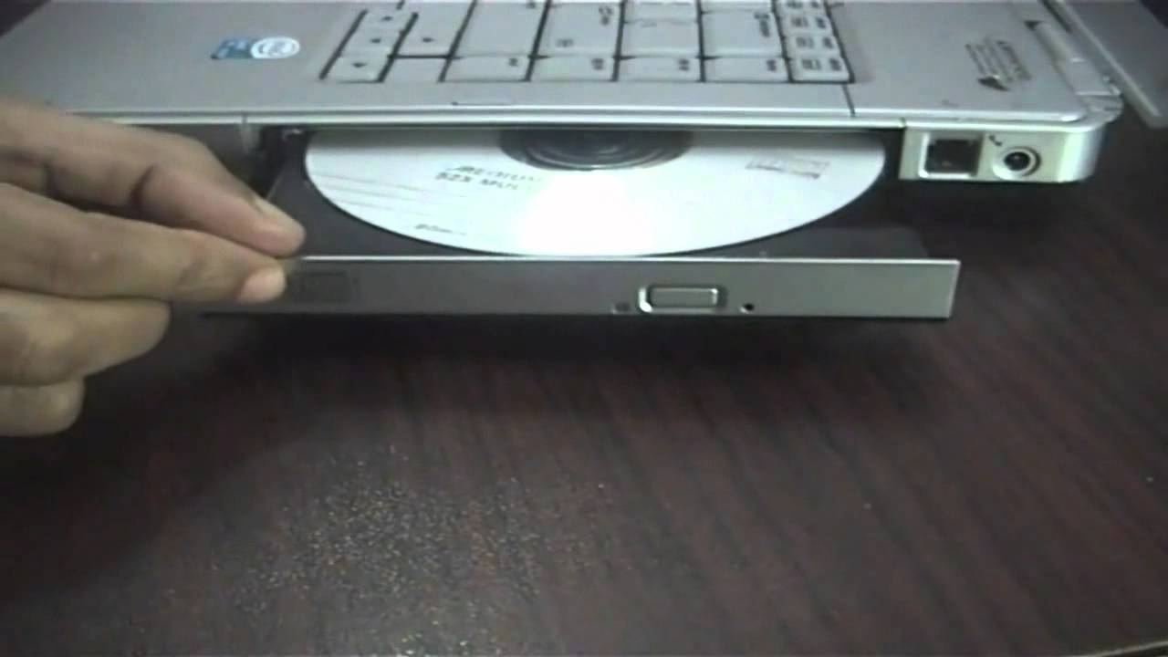
Helpers for non-choir Masses to operate DVD and computer
7th October, 7pm
Notes:
Volunteers willing to use the computer during Mass to display powerpoint and DVD are invited to attend an information evening on the 7th October 7pm. Contact Paul Scott or just turn up on the night.

Slide 113

Can you help with Church cleaning on a Friday afternoon at 1.30 pm.
For further information contact Vicky Sammut

Slide 114

The SVDP pantry needs to restock the following items:
Long life milk, Biscuits, 2 min noodles, Cereal and Baked Beans
Many thanks for your support

Slide 115
BISHOP’S SOCIAL JUSTICE STATEMENT AVAILIABLE AT CHURCH ENTRANCE

Slide 116

Please take home your bulletins or download it from
www.stmichaelsparish.com
  www.facebook.com/
  blacktowncatholics

Slide 117
This slide is hidden.
The next slide can be used for videos.
Insert the video into the slide.

Slide 119
Priest: The Lord be with you.
All: And with your spirit.

Slide 121
This slide is hidden.
Insert the Recessional Hymns after this slide.

Slide 122
Shine Jesus shine
Lord, the light of your love is shining
In the midst of the darkness, shining
Jesus, Light of the world, shine upon us
Set us free by the truth you now bring us
Shine on me, shine on me

Slide 123
Shine, Jesus, shine
Fill this land with the Father's glory
Blaze, Spirit, blaze
Set our hearts on fire

Slide 124
Flow, river, flow
Flood the nations with grace & mercy
Send forth your word
Lord, and let there be light

Slide 125
As we gaze on Your kindly brightness.
So our faces display Your likeness.
Ever changing from glory to glory,
Mirrored here may our lives tell Your story.
Shine on me. Shine on me.

Slide 126
Shine, Jesus, shine
Fill this land with the Father's glory
Blaze, Spirit, blaze
Set our hearts on fire

Slide 127
Flow, river, flow
Flood the nations with grace & mercy
Send forth your word
Lord, and let there be light

Slide 128
This slide is hidden.
Insert the final slide here.

